Slide 1

7th Grade Math
Unit 10, Lesson 6 Solving Two-Step Equations Volume 2, pg. 117

Slide 2


Benchmark
MA.7.AR.2.2
Write and solve two-step equations in one variable within a mathematical context or real-world context, where all terms are rational numbers.
volume 2, pg. 117

Slide 3
Integrated Mathematical Thinking and Reasoning Standards
MA.K12.MTR.1.1 Actively participate in effortful learning both individually and collectively.
MA.K12.MTR.2.1 Demonstrate understanding by representing problems in multiple ways.
MA.K12.MTR.4.1 Engage in discussions that reflect on the mathematical thinking of self and others.
MA.K12.MTR.5.1 Use patterns and structure to help understand and connect mathematical concepts.
MA.K12.MTR.7.1 Apply mathematics to real-world contexts.
volume 2, pg. 117

Slide 4

Learning Targets
I can solve two-step equations in one variable.
I can relate the solution of an equation representing a real-world context to the context.
volume 2, pg. 117

Slide 5

Warm-Up
volume 2, pg. 118

Slide 6
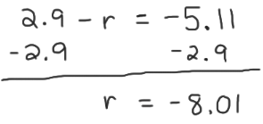

10.6.1 Warm-Up: Bell Work
Michaela solved the equation $2.9−r=−5.11$. Her work is shown.
Use substitution to verify if Michaela’s solution is correct.
volume 2, pg. 118

Slide 7
If Michaela found the correct solution, describe the properties of equality applied. If Michaela did not find the correct solution, describe the error(s) she made.
volume 2, pg. 118

Slide 8

Collaboration
volume 2, pg. 118

Slide 9

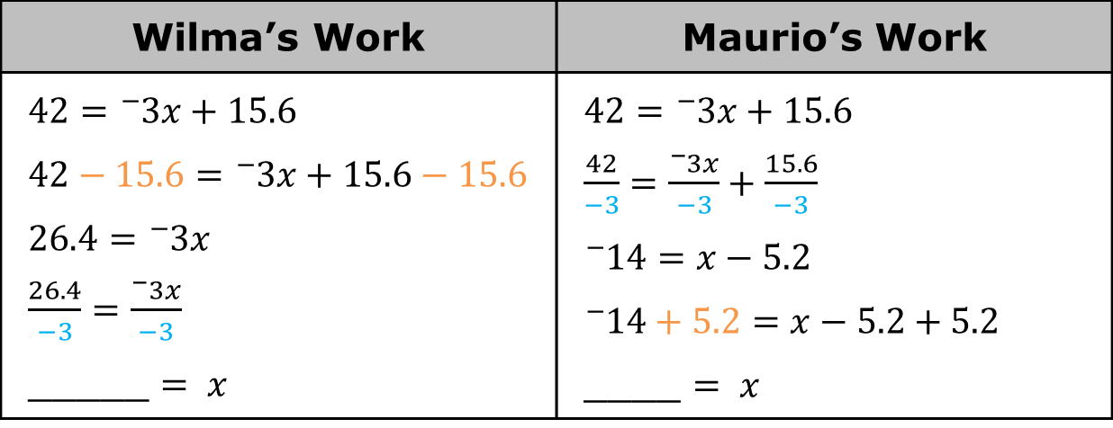
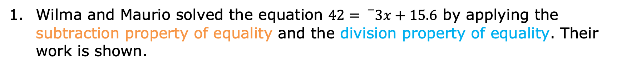
10.6.2 Collaboration: Examining Student Work
Wilma and Maurio solved the equation $42={}_{}^{−}{3x}+15.6$ by applying the subtraction property of equality and the division property of equality. Their work is shown.
Wilma’s Work | Maurio’s Work
$$42={}_{}^{−}{3x}+15.6$$ $$42−15.6={}_{}^{−}{3x}+15.6−15.6$$ $$26.4={}_{}^{−}{3x}$$ $\frac{26.4}{−3}=\frac{{}_{}^{−}{3x}}{−3}$ _____ $= x$ | $$42={}_{}^{−}{3x}+15.6$$ $\frac{42}{−3}=\frac{{}_{}^{−}{3x}}{−3}+\frac{15.6}{−3}$ $${}_{}^{−}{14}=x−5.2$$ $${}_{}^{−}{14}+5.2=x−5.2+5.2$$ ____ $= x$
volume 2, pg. 118

Slide 10
Complete the last step in each student’s work. Then, check your work with your partner.
Discuss the similarities and differences between each students’ work with your partner. Summarize your discussion in the table.
How are the students’ work similar? | How are the students’ work different?
volume 2, pg. 118

Slide 11
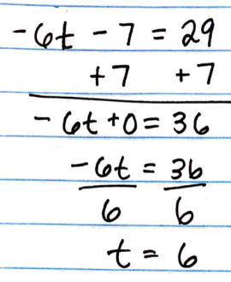
Notice that when division property of equality is applied first, each term in the equation must be divided by the same value to maintain equivalence.
Several students made errors when solving equations. Their work is shown in the table.
Work with your partner to find the error in each student’s work. Circle the step where the student made the error. Then, work together to complete the table.
Student Work | Describe the Error | Correct Solution
volume 2, pg. 119

Slide 12
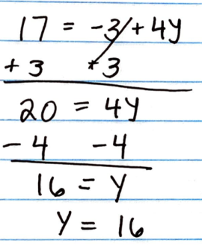
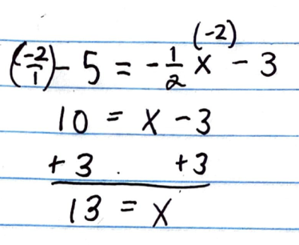
Student Work | Describe the Error | Correct Solution
volume 2, pg. 119

Slide 13

Guided Instruction
volume 2, pg. 119

Slide 14
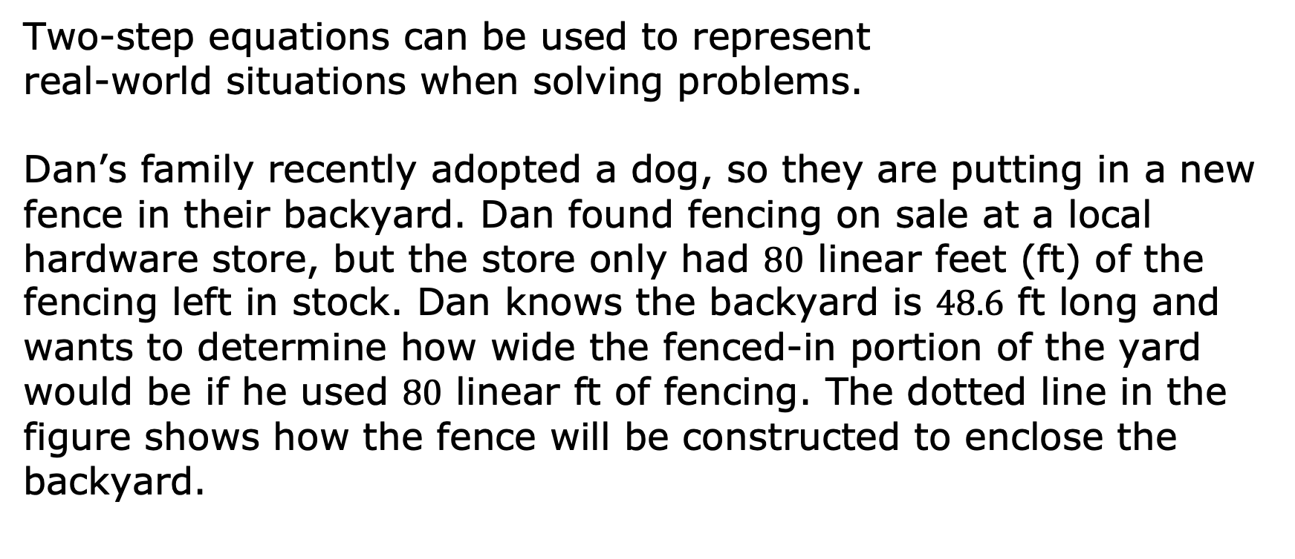
10.6.3 Guided Instruction: Relating Equations and Their Solutions to Real-World Contexts
Two-step equations can be used to represent real-world situations when solving problems.
Dan’s family recently adopted a dog, so they are putting in a new fence in their backyard. Dan found fencing on sale at a local hardware store, but the store only had $80$ linear feet (ft) of the fencing left in stock. Dan knows the backyard is $48.6$ ft long and wants to determine how wide the fenced-in portion of the yard would be if he used $80$ linear ft of fencing. The dotted line in the figure shows how the fence will be constructed to enclose the backyard.
volume 2, pg. 119

Slide 15
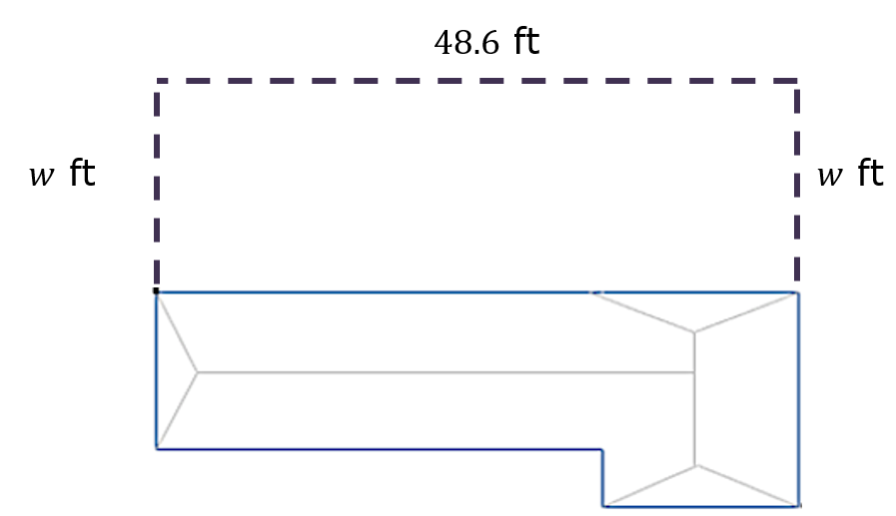

The equation $48.6+2w=80$ can be used to determine how wide the fenced-in portion of the yard will be.
Solve $48.6+2w=80$. Show your work.
volume 2, pg. 119

Slide 16
Verify your solution is correct.
Explain what the solution means in this context.
volume 2, pg. 120

Slide 17
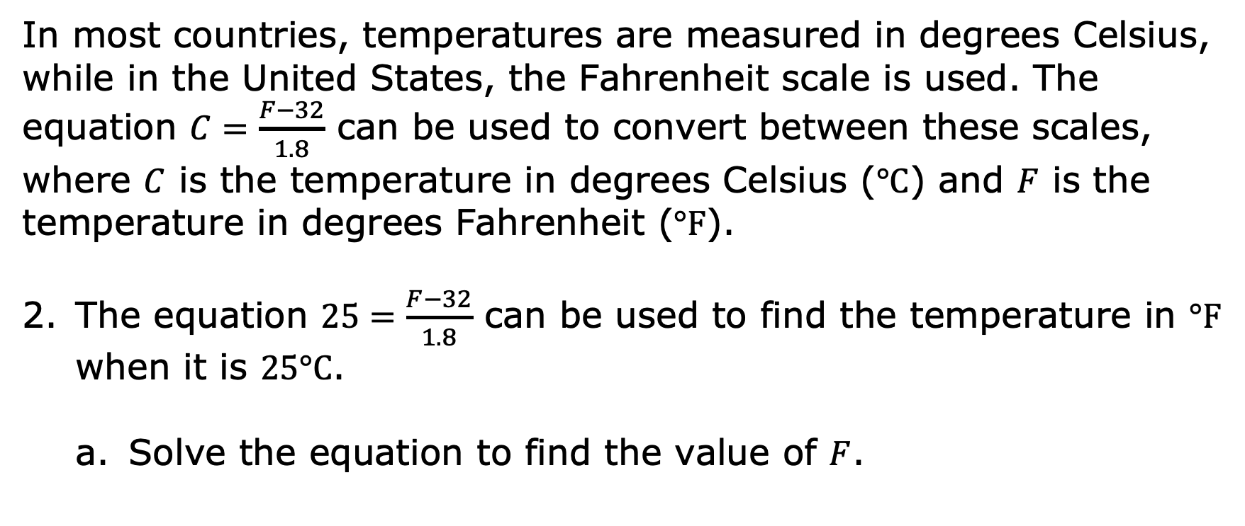
In most countries, temperatures are measured in degrees Celsius, while in the United States, the Fahrenheit scale is used. The equation $C=\frac{F−32}{1.8}$ can be used to convert between these scales, where $C$ is the temperature in degrees Celsius ($°C$) and $F$ is the temperature in degrees Fahrenheit ($°F$).
The equation $25=\frac{F−32}{1.8}$ can be used to find the temperature in $°F$ when it is $25°C$.
Solve the equation to find the value of $F$.
volume 2, pg. 120

Slide 18
Verify your solution is correct.
Explain what the solution means in this context.
volume 2, pg. 120

Slide 19

Your Turn
volume 2, pg. 121

Slide 20
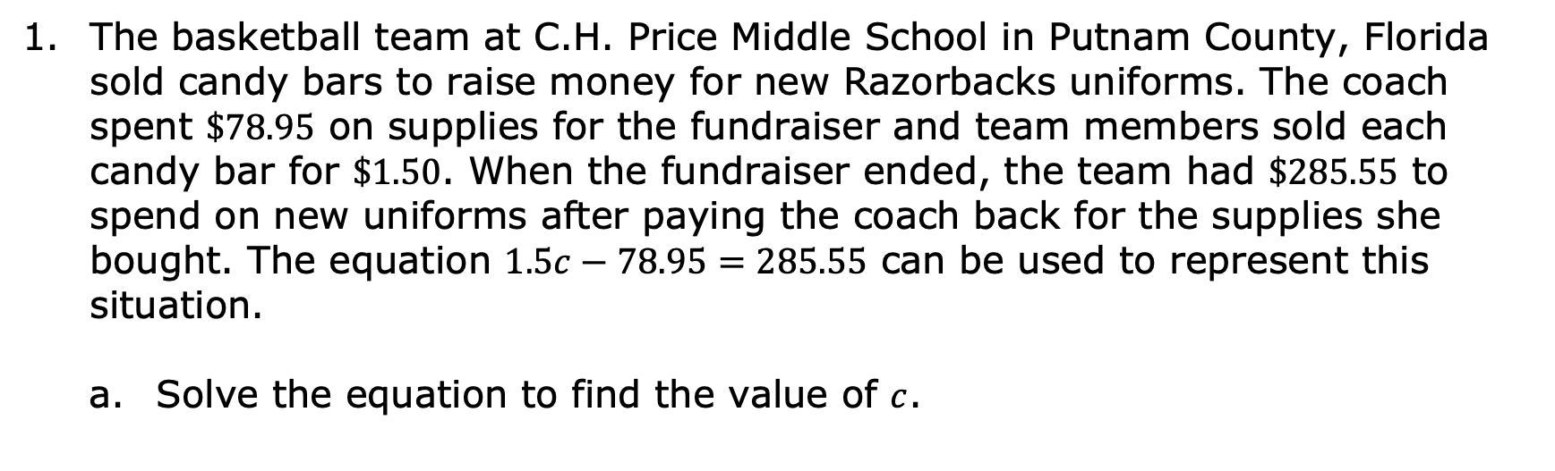
10.6.4 Your Turn!
The basketball team at C.H. Price Middle School in Putnam County, Florida sold candy bars to raise money for new Razorbacks uniforms. The coach spent $\$78.95$ on supplies for the fundraiser and team members sold each candy bar for $\$1.50$. When the fundraiser ended, the team had $\$285.55$ to spend on new uniforms after paying the coach back for the supplies she bought. The equation $1.5c−78.95=285.55$ can be used to represent this situation.
Solve the equation to find the value of $c$.
volume 2, pg. 121

Slide 21
Verify your solution is correct.
Explain what the solution means in this context.
volume 2, pg. 121

Slide 22

Solve $−10\frac{1}{3} + \frac{x}{6} = −\frac{8}{3}$ using the properties of equality. Then, verify your solution is correct.
Solve $−9.2=\frac{m+7.22}{4}$ using the properties of equality. Then, verify your solution is correct.
volume 2, pg. 121

Slide 23

Wrap-Up
volume 2, pg. 122

Slide 24
10.6.5 Wrap-Up: Growth Mindset
Mistakes are an opportunity to learn. Describe your favorite mistake from today’s lesson which could be a mistake you made or observed that helped you learn.
Means
I
Start
To
Acquire
Knowledge
Experience
Skills
volume 2, pg. 122

